Slide 1
Log Analyzer Bot
By
Surya Ajay Kumar
Department of Cyber Security
Shashidhar
Cyber security Trainer

Slide 2
Contents :
Abstract
Introduction
System Analysis
Architectural Design
Implementation
Results
Conclusion
Future Scope

Slide 3
Abstract :
The growing increase of unauthorized SSH login attempts is creating a serious risk to any Linux based operating system. The "Log Analyzer Bot" is a shell based automation that performs log analysis as a way of identifying insecure login SSH activities to improve security. The main target is to analyze the /var/log/auth.log to identify SSH login failures when a user could not log in to the system. The bot uses the grep and awk tools to extract a number of important components e.g. the IP address, the username and the frequency of the attempts and consolidates this data to produce a descriptive report of potential malicious activity.
The bot will automatically block any addresses which exceed the defined threshold using ufw (Uncomplicated Firewall). This process is all automated and scheduled by Cron to further protect your system from brute-force attacks which require no manual intervention from the user. The combination of standard Unix tools and firewall management makes Log Analyzer Bot a simple, lightweight and effective answer to address the security of your remote access services.

Slide 4
Introduction
As the number of unauthorized breach attempts on Linux servers increase, especially on SSH services, demand for automated security monitoring is also increasing. The Log Analyzer Bot is a shell script to automatically scan system authentication logs (/var/log/auth.log) to find failed login attempts via SSH. In order to find abnormal patterns, it scan the selected log for evidence of abnormal login failure requests (multiple failures coming from the same IP). When network failure requests from an IP exceed a particular limit, the bot will use the system firewall (ufw) to block the offending IP and protect the system from brute-force attacks. The bot can be cron scheduled as needed to run at periodic intervals without manual intervention. Using the Log Analyzer Bot is an uncomplicated way to enhance server security.

Slide 5
System Analysis
The Log Analyzer bot is a Linux-based automation script that monitors SSH login attempts and suspicious activities. It checks the /var/log/auth.log file for failed login entries, uses tools such as grep and awk to extract the IP address and usernames, and counts the number of failed login attempts. When an IP address exceeds a predetermined number of failed login attempts (for example, 5 attempts), the bot will automatically block the offending IP address using the ufw firewall. The bot will run periodically through cron jobs in order to provide continuous monitoring. This lightweight tool will improve security on the system as it may help to prevent brute-force attacks with minimal overhead to the system. Future versions of the bot may include future enhancements such as email alerting, graphical reports or interface, or integration with security tools.

Slide 6
Architectural Design
/var/log/auth.log
↓
Log Analyzer Script
↓
Extract IP, User, Count
↓
Threshold Check
↓ ↘
Block IP (ufw) , Skip IP
↓
Log Blocked IPs
↓
Cron Scheduled Execution

Slide 7


Implementation:

Slide 8



Slide 9

Result

Slide 10
Future scope:
Email/SMS Alerts: Send notifications when an IP is blocked, a threshold has been exceeded, or a configuration had been changed.
HTML/CSV Reporting: Generate user-friendly reporting for audit and review.
SIEM Integration: Send logs to Security Information and Event Management (SIEM) tools.
Real-Time Dashboard: A web based interface to visualize the attack patterns and actions taken by the system.
User Whitelisting: Add support for trusted IPs or users to completely avoid false blocking.
AI/ML Integration: Integrate machine learning to detect abnormal login patterns using a more intelligent approach.
Multi-Service Support: Add monitoring support for other services (FTP, HTTP, SMTP) logs.

Slide 11
GUI (graphical user interface)
Tools & Technologies:
Language: Python
GUI: Tkinter (or PyQt5)
Log Parsing: re, collections
System Interaction: linux os, ufw, /var/log/auth.log
Data Export: CSV
Automation : Cron jobs

Slide 12
Front End implementation:
The front-end implementation of the GUI-Based Log Analyzer Bot on Linux front end was developed incorporating Python's Tkinter library. Tkinter offers a simple and effective way to build desktop applications. The GUI allows users to interact with the log analyzer in an easy-to-use GUI so that they do not need to use the terminal. The front end has various components: input fields so users can set a threshold for failed login attempts and buttons to run the log analysis, export results to CSV, and even manually block IP address using the system’s firewall (ufw). The results are displayed in a scrollable text area showing the IP addresses and the number of failed SSH login attempts, parsed from /var/log/auth.log . The application also has a back-end parser script that implements regular expressions and Python’s collections.Counter to scan the log file for suspicious activity. Overall, the GUI eases the monitoring of login attempts and user actions; making overall usability easier to apply accessible controls to review logs and follow up with appropriate security actions.

Slide 13
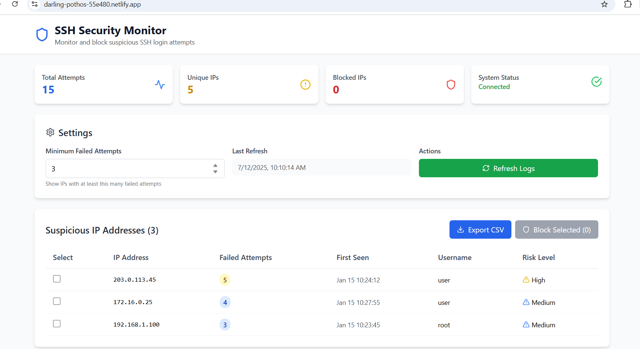

Slide 14
Conclusion:
The Log Analyzer Bot successfully automates the process of monitoring and analyzing SSH login attempts on Linux systems. Using simple but effective bash, grep, awk, cron, ufw, and other tools, it identifies if a user appears to attempt suspicious logins, and blocks potentially malicious IP addresses in real time; enhancing server security, and further reducing the risks of brute-force login attacks without manual observation. The project is a clear example of how scripting can be combined with existing Linux utilities to allow for an effective and automated security tool.

Slide 15
THANK YOU

